Slide 1
Selected 2 Project

Slide 2
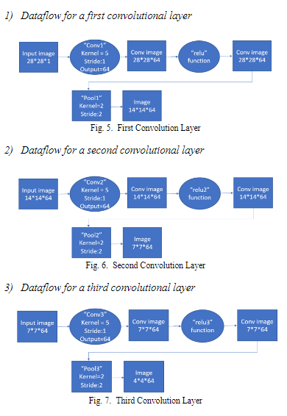
Architecture used in the Paper

Slide 3
DataSet Details
Datasets for it : Rock Paper Scissors Dataset
It includes 2925 files for (Training & Testing)
3 classes rock,paper and Scissors
Training (3 directories)
Rock
paper
Scissors
Testing (3 directories)
Rock
paper
Scissors
dimension of images = 300*300px

Slide 4
Implementation details:
We used 80% of the training data for the training and 20% for the validation
We have:
Training (2016)
Validation(504)
Testing (372)

Slide 5
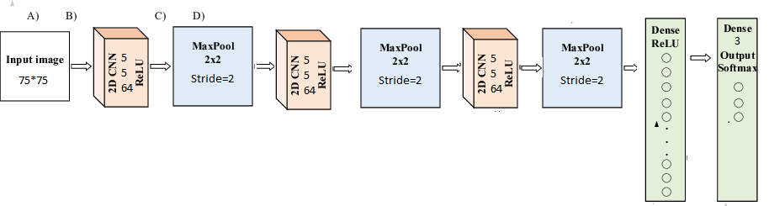
Block diagram

Slide 6
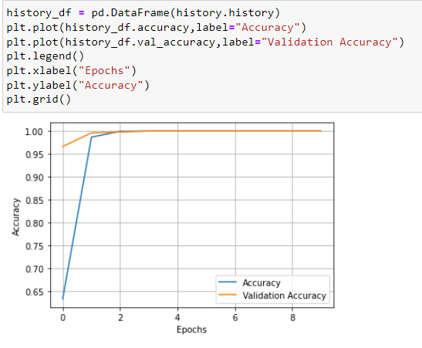
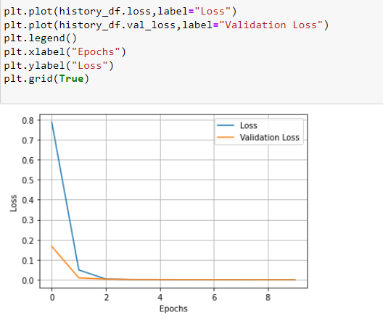
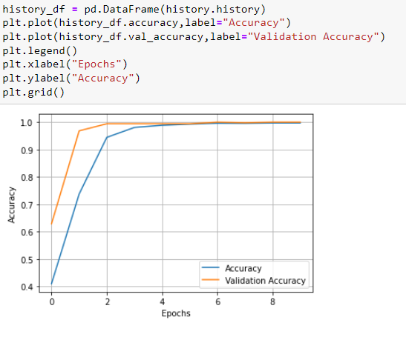
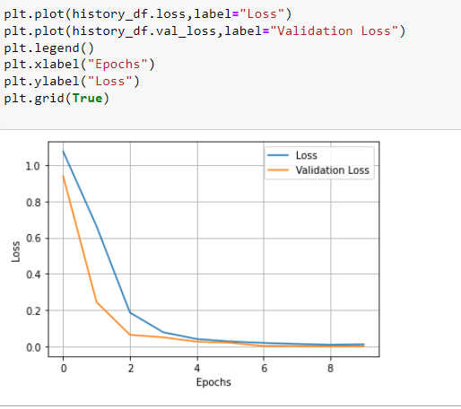
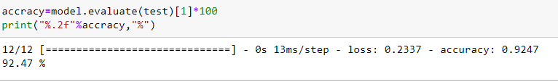
Results details:
We have Accuracy After the optimization 92.7
And That is our training and validation curves

